Slide 1
DIAGNOSTIC CLASSIFICATION OF LUNG NODULES USING 3D NEURAL NETWORKS
Ramin Kamali
Mohammadreza Davoodi

Slide 2
Problem : lung nodule classification
Lung cancer is one of the most dangerous cancers
Time is an important factor to reduce mortality rate
Doctors need more information
Handcraft feature extracting is slow

Slide 3
Deep learning
pros :
It saves time and money
High-level feature
Better quality
Cons :
Need a lot of data
But medical data sets aren’t big enogh

Slide 4
Using 3D convolution network
pros :
CT-scans are 3D
Extract more informations
Cons :
High complexity

Slide 5
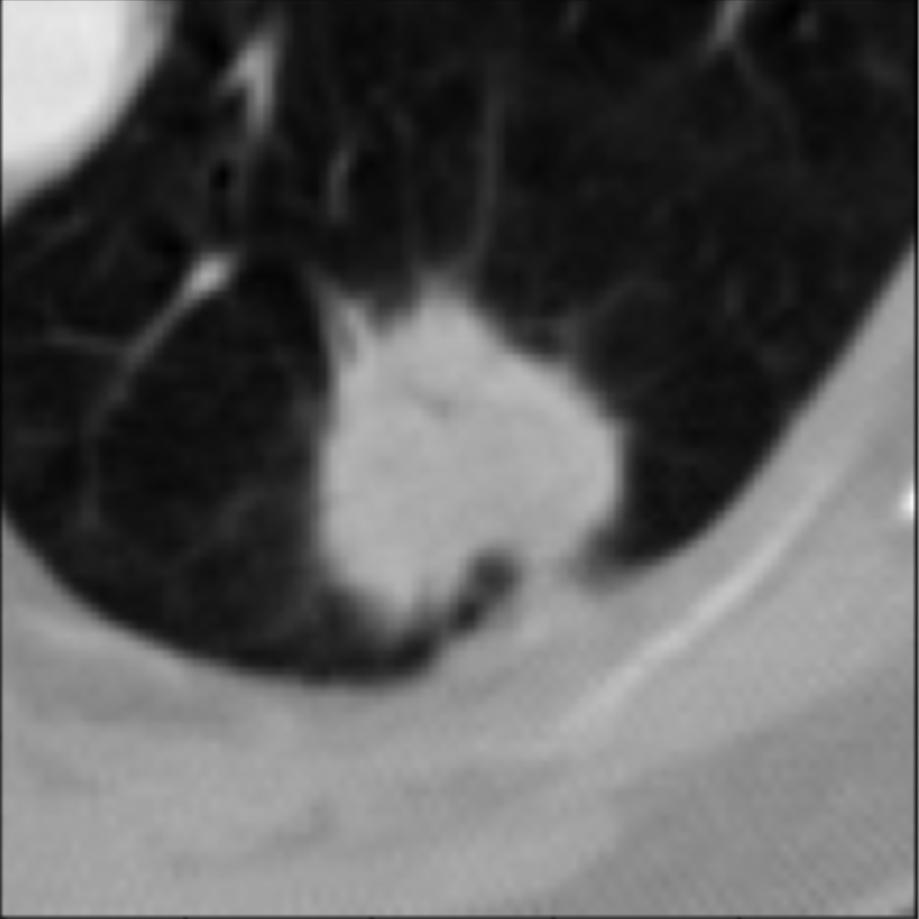
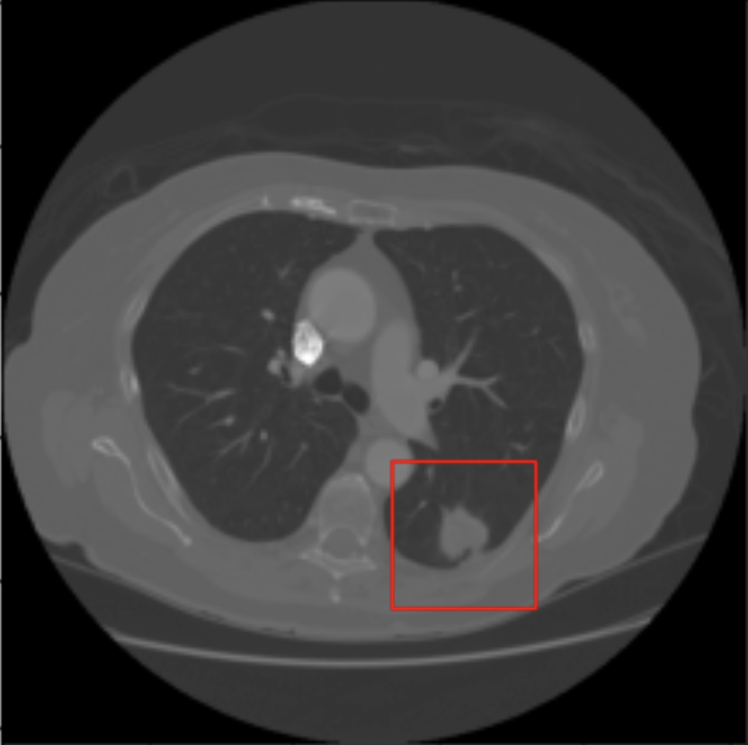
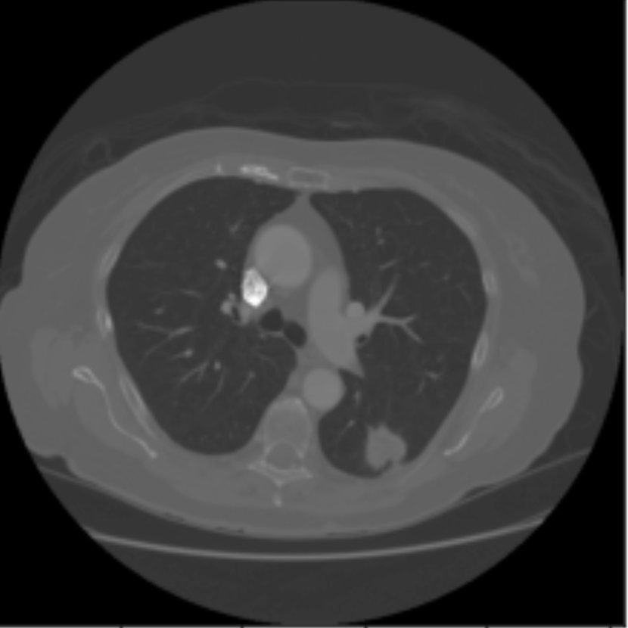
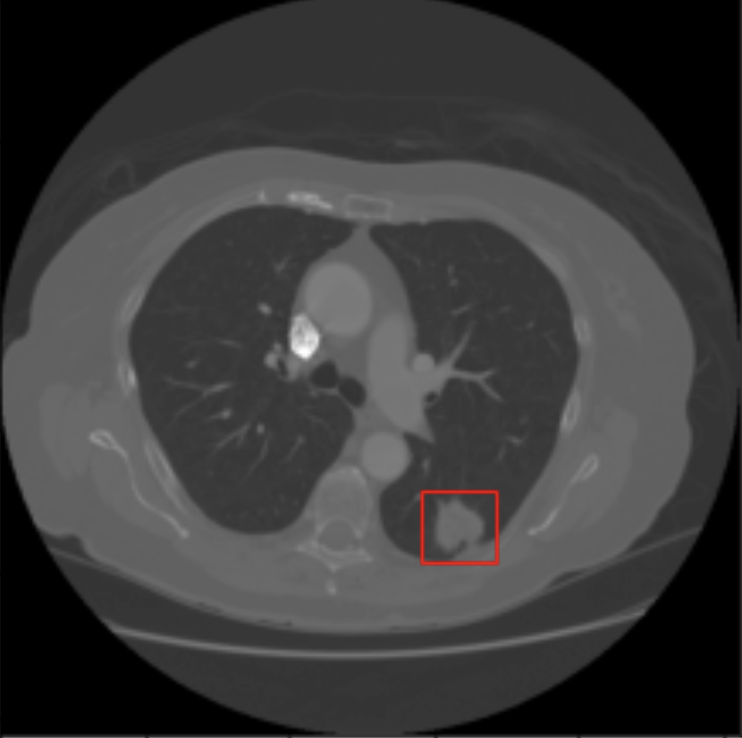
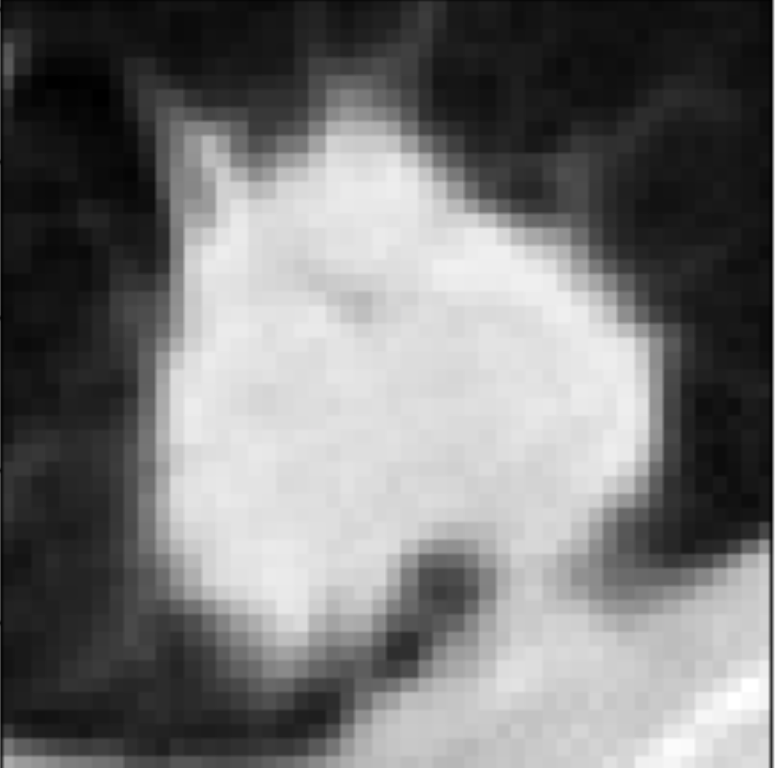
Dataset : LIDC-IDRI
1012 3D CT-Scans

Slide 6
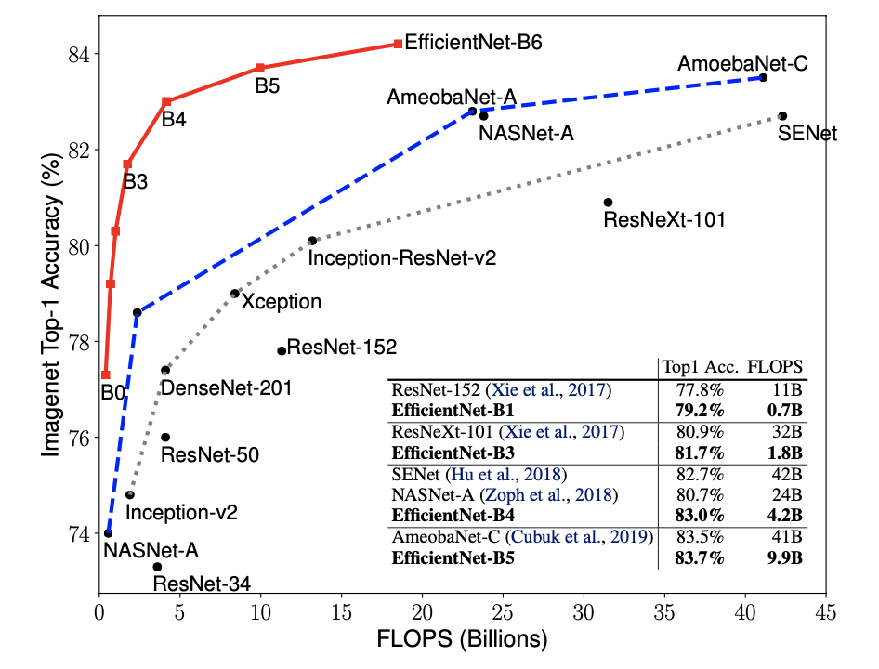
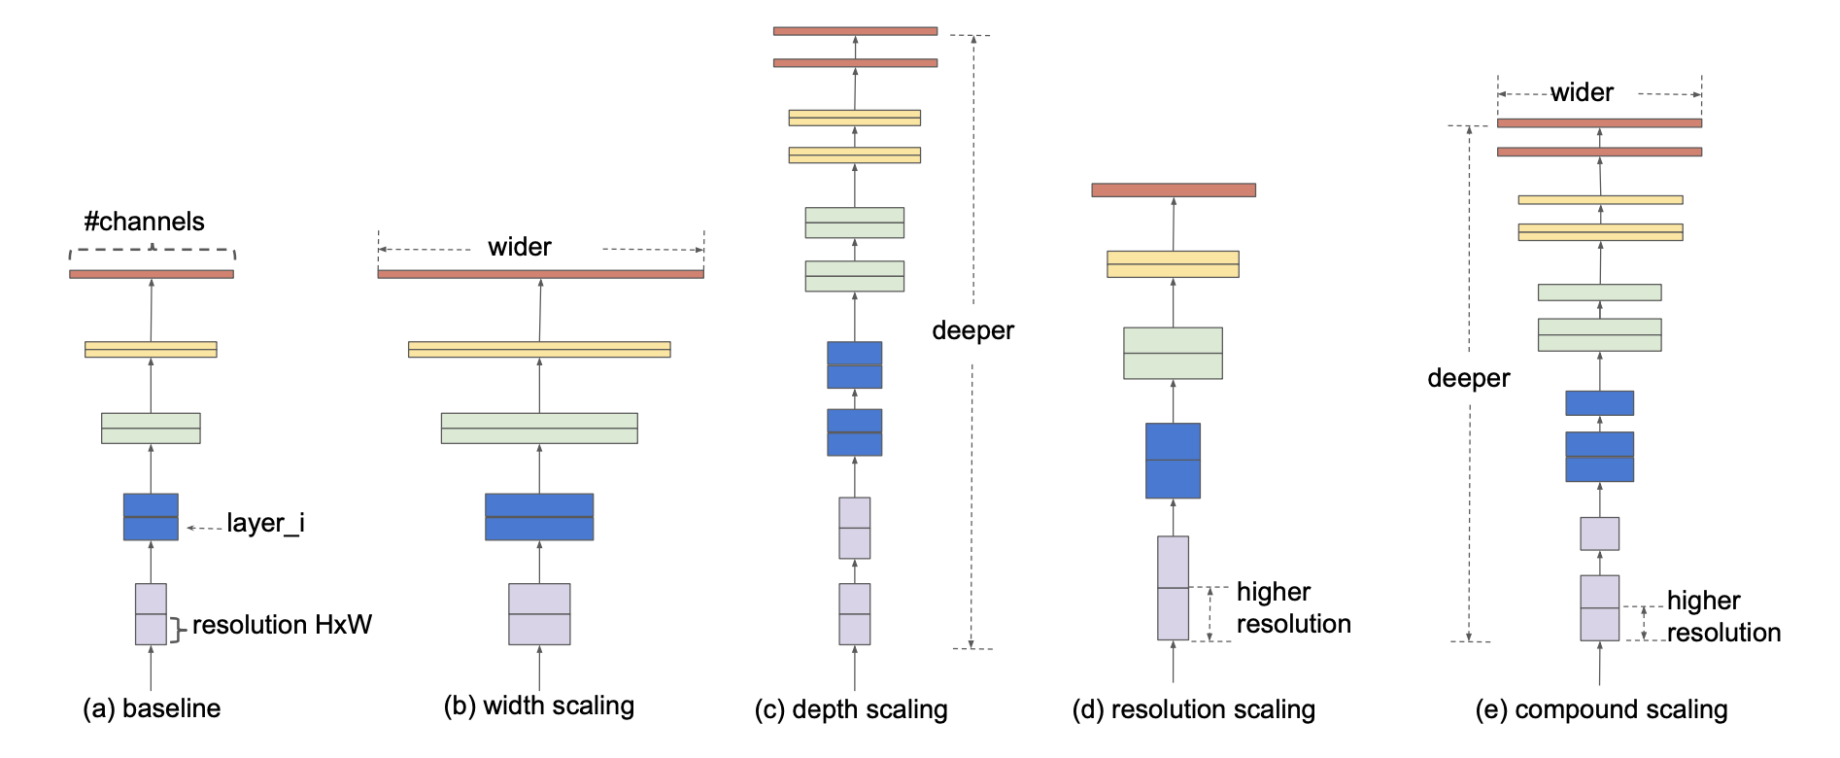
EfficientNet idea
Improve network in depth, width & Resolution

Slide 7
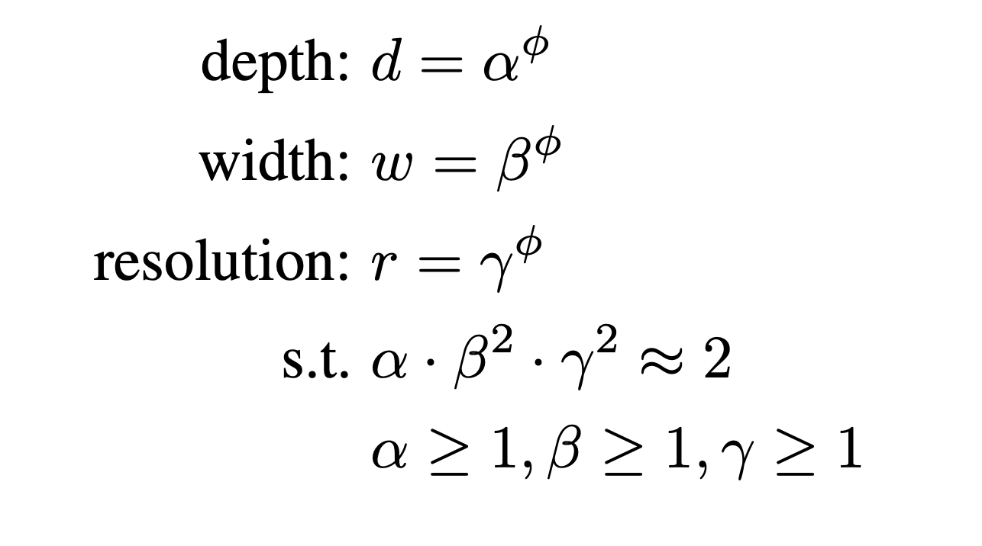
EfficientNet idea

Slide 8
Multi-conv idea

Slide 9
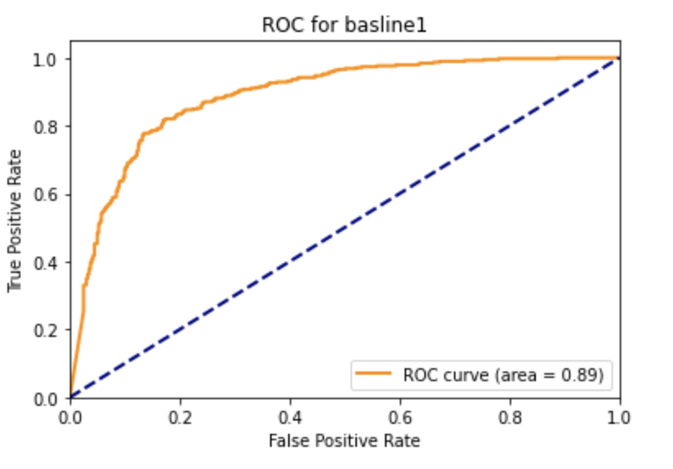
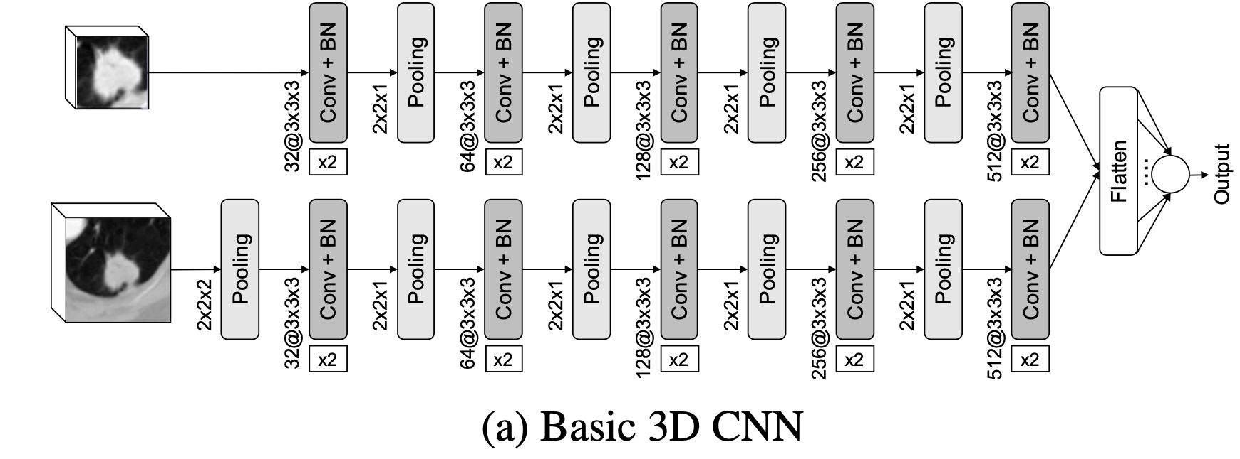
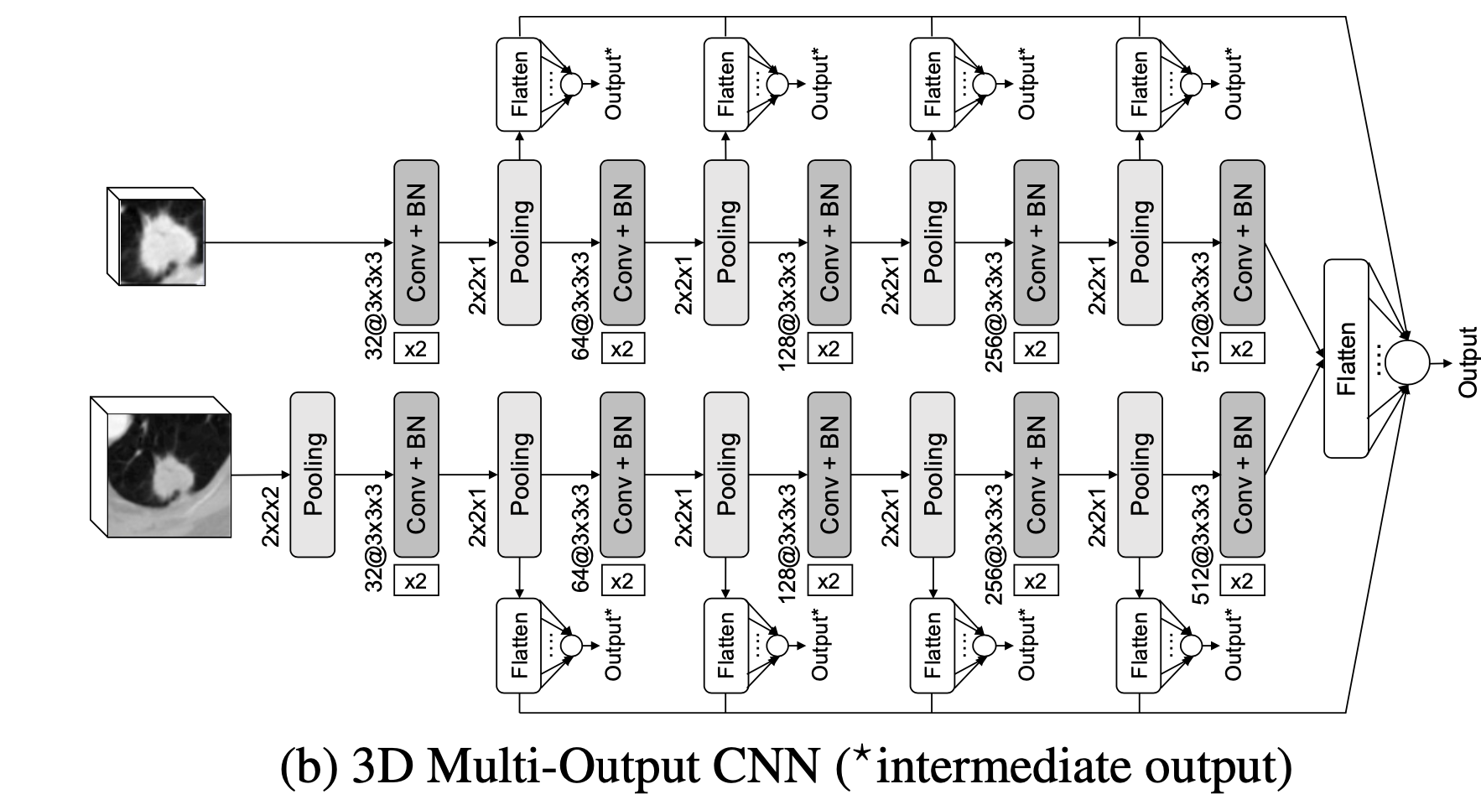
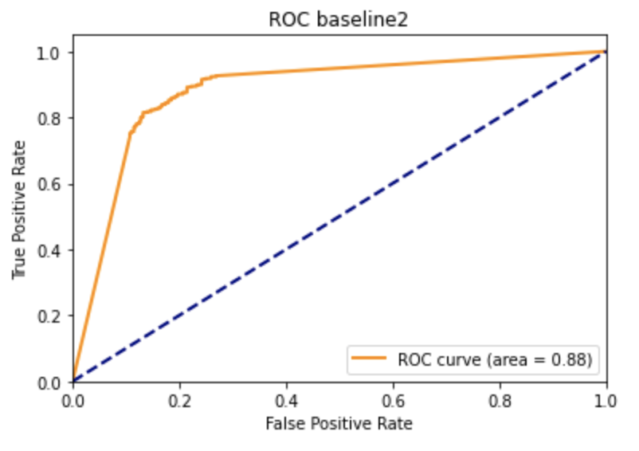
Baseline Networks :

Slide 10
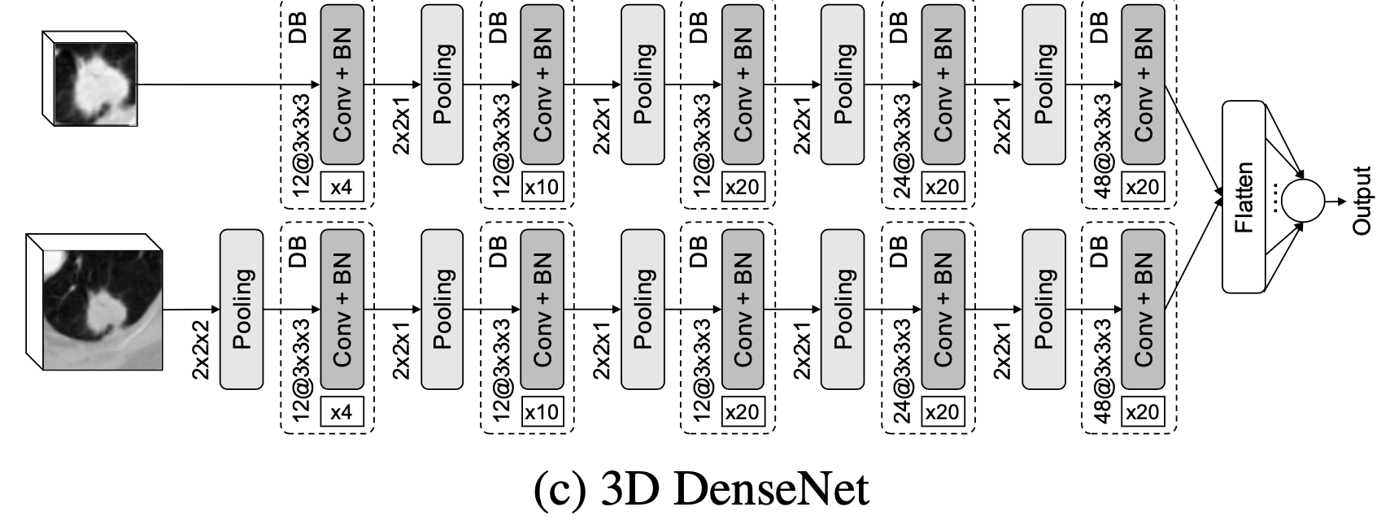
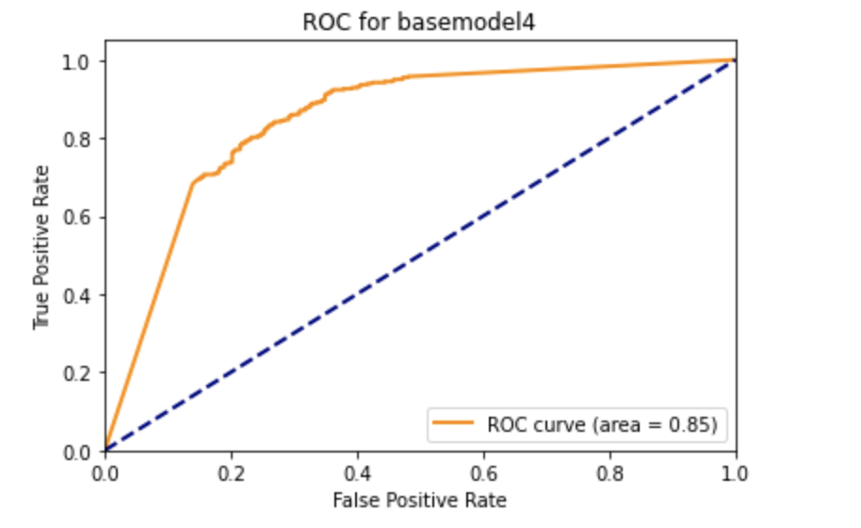
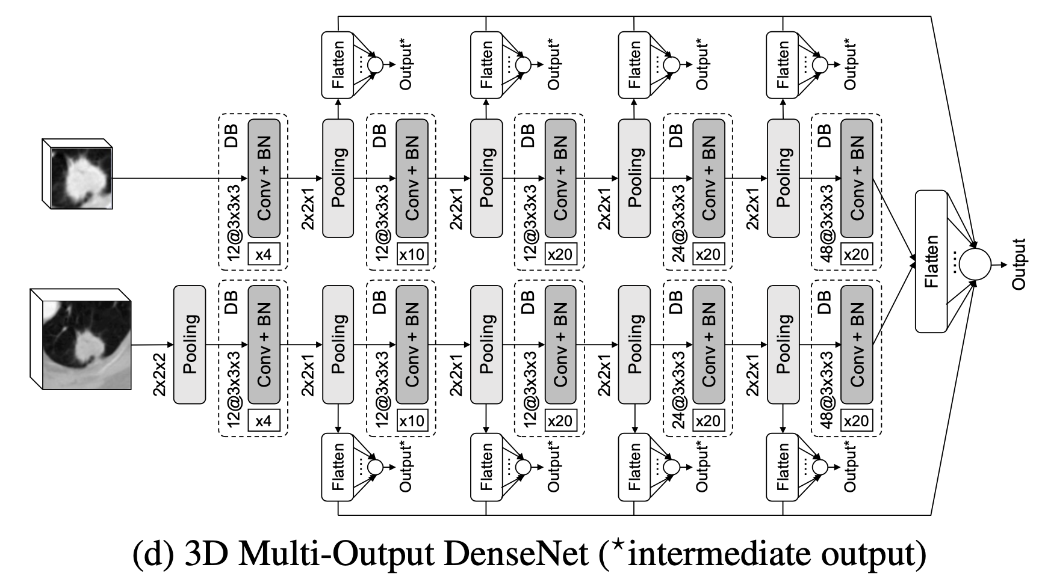
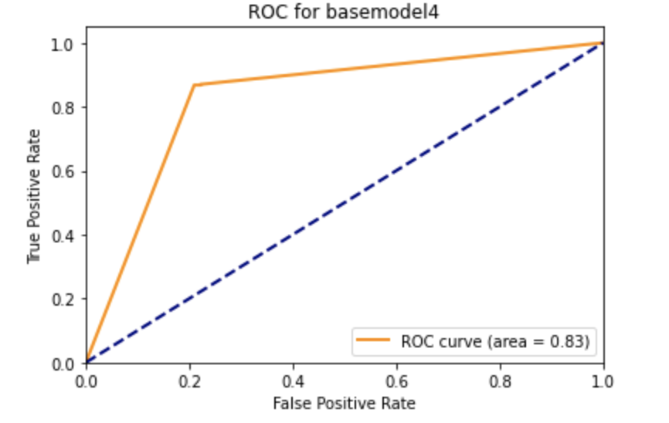
Baseline Networks :

Slide 11
efficientNet network

Slide 12
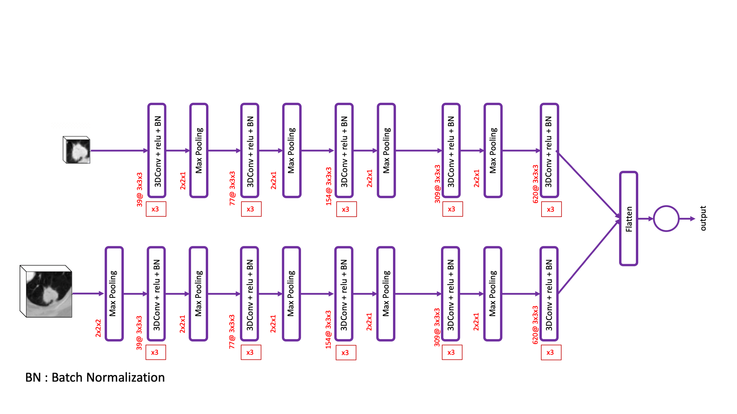
efficientNet network

Slide 13
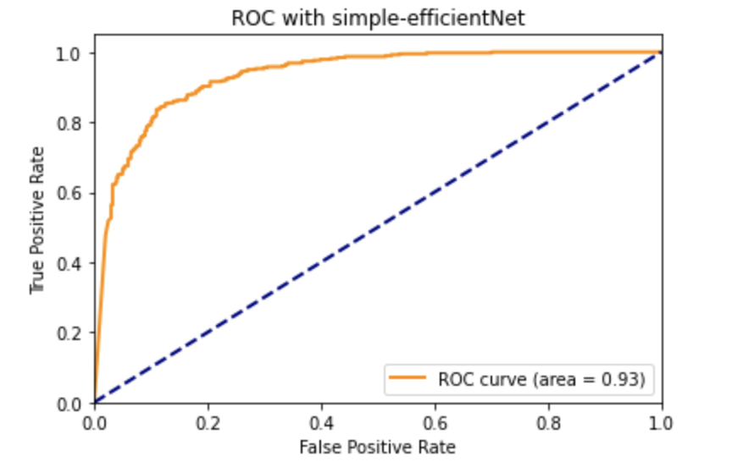
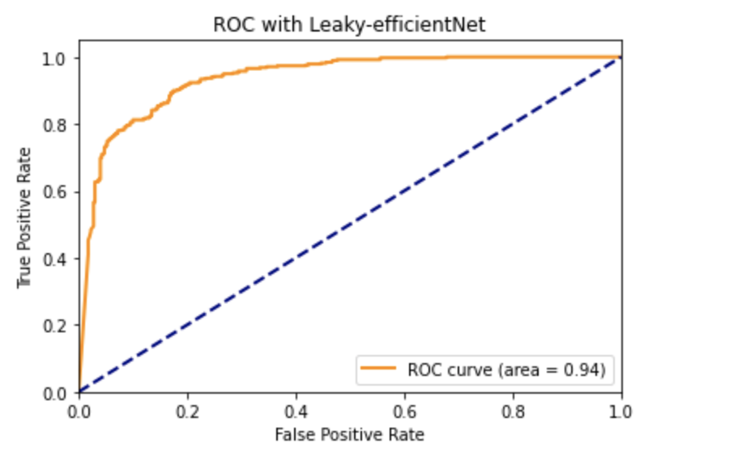
New Networks :
Simple efficientNet
efficientNet with Leaky Relu

Slide 14
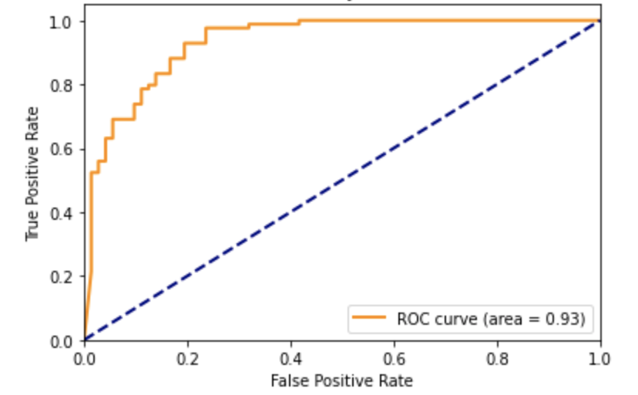
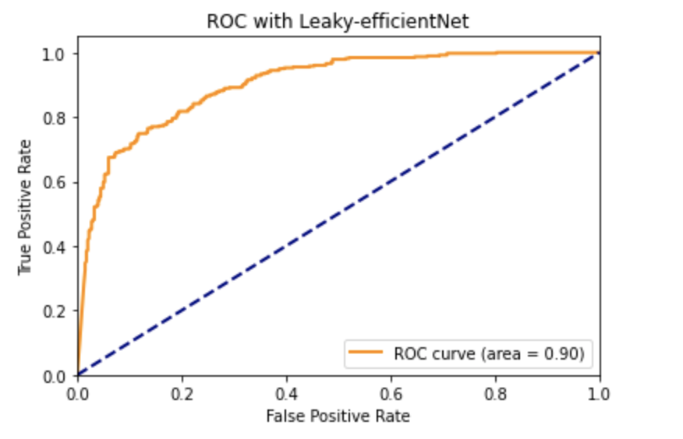
New Networks :
Multi-conv efficientNey + Leaky Relu
Shared efficientNet + Leaky Relu

Slide 15
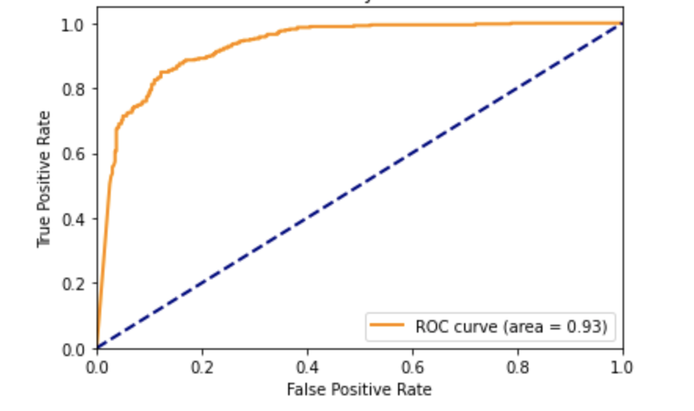
New Networks :
Residual efficientNet + leaky Relu

Slide 16
Results :
 | AUC | TPR | TNR | PPV | ACC
baseline1 | 0.89 | 0.84 | 0.79 | 0.79 | 0.81
baseline2 | 0.88 | 0.78 | 0.87 | 0.85 | 0.82
baseline3 | 0.85 | 0.76 | 0.79 | 0.77 | 0.78
baseline4 | 0.83 | 0.86 | 0.79 | 0.79 | 0.82
Simple-efficientNet | 0.93 | 0.86 | 0.85 | 0.84 | 0.85
efficientNet + leaky Relu | 0.94 | 0.87 | 0.83 | 0.83 | 0.85
shared | 0.90 | 0.78 | 0.82 | 0.81 | 0.80
Multi-conv | 0.93 | 0.86 | 0.84 | 0.80 | 0.85
Residual + eff | 0.93 | 0.86 | 0.84 | 0.84 | 0.85

Slide 17
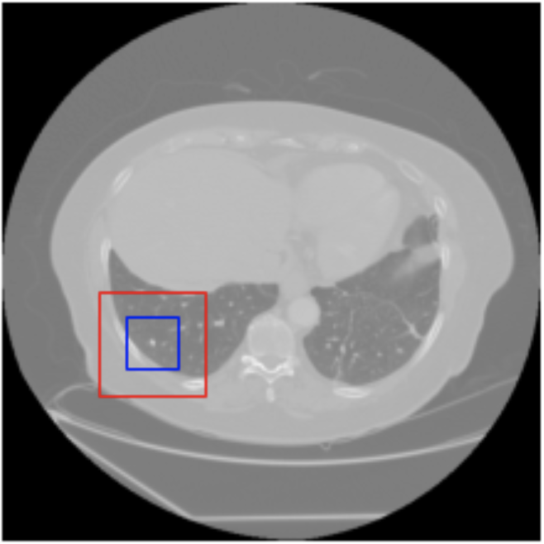
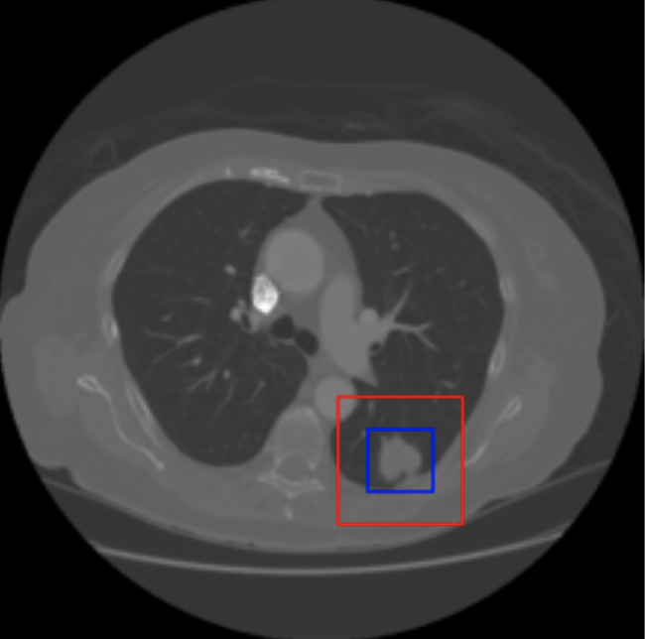
Results :
Ground truth : benign
Prediction : benign
Ground truth : malignant
Prediction : malignant

Slide 18
Questions ??

